Slide 1

EMF investigation
Tesla model X and BMW 740Le
Philip McGaw
Notes:
Select one of these pre-defined front pages and delete the rest. This document will be updated regularly to ensure product images are current.
Please note that for all internal presentations you must use the dual brand template, even if your content is single brand. Only use the single brand template
for external presentations, product launches or brand immersion events.

Slide 2
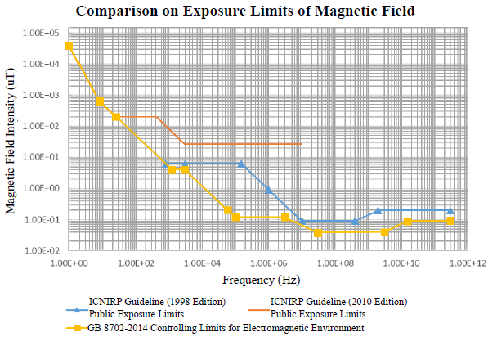
GB 37130:2018 Limits
GB 37130:2018 Calls the limits from GB 8702:2014.
GB 8702 is more onerous than the limits in either ICNIRP 1998 or 2010.
The graphs provided in this document normalise the Y axis as a percentage of limit line at each frequency.
The Y axis are not all to the same scale.
The instrument used to record the data has a limited span size, therefor the range has to be split into multiple scans.
GB 8702:2014 is applicable for 10 Hz to 400 kHz

Slide 3
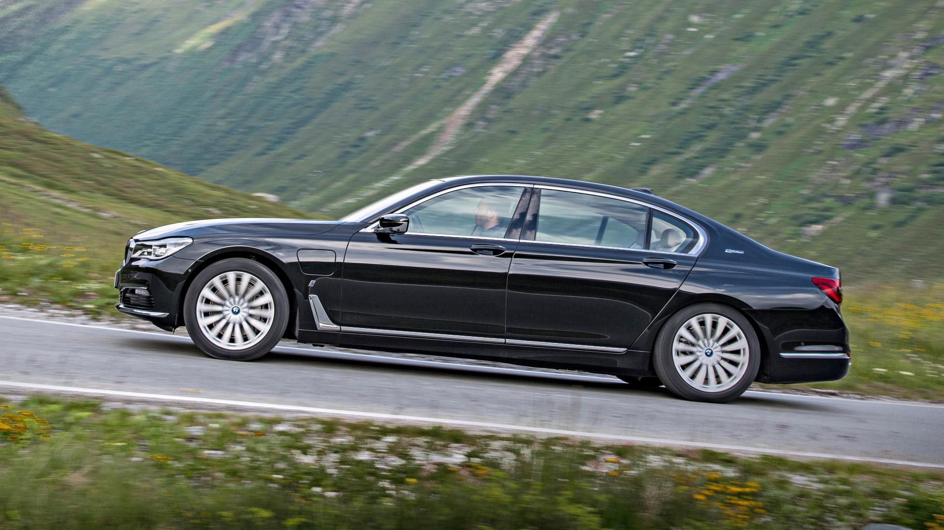
BMW 740Le

Slide 4
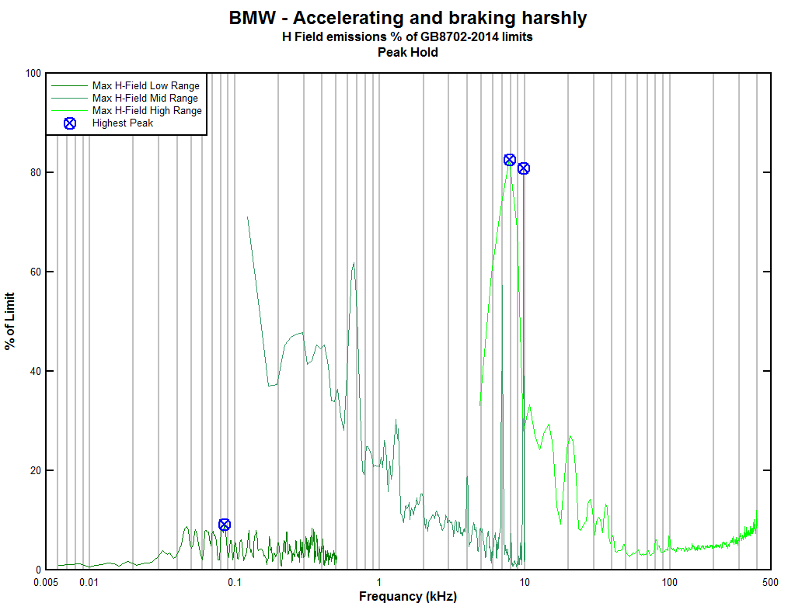
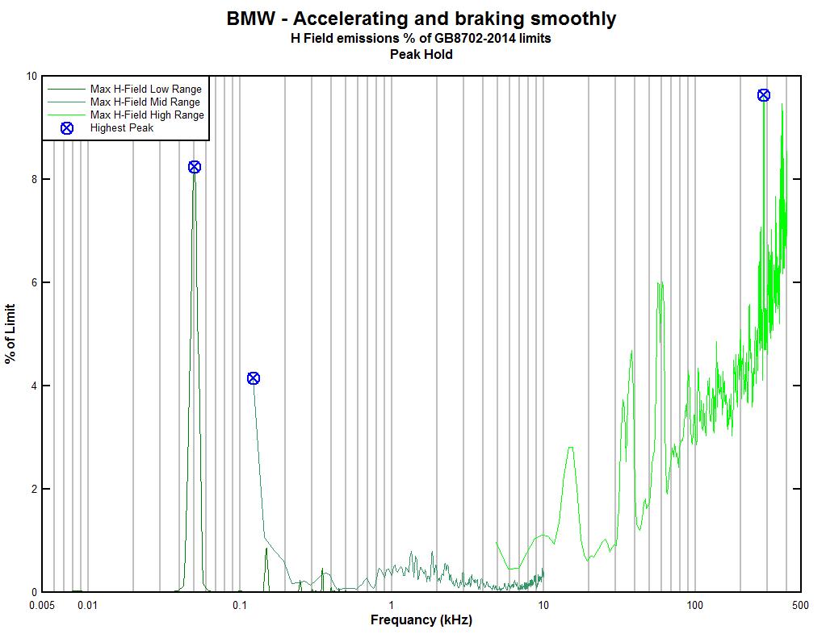
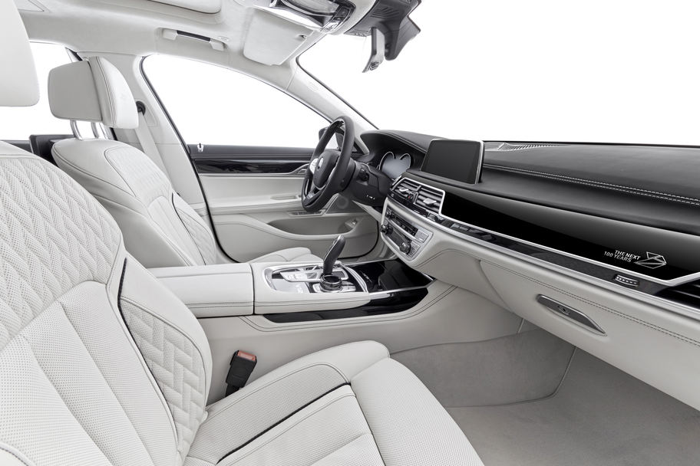
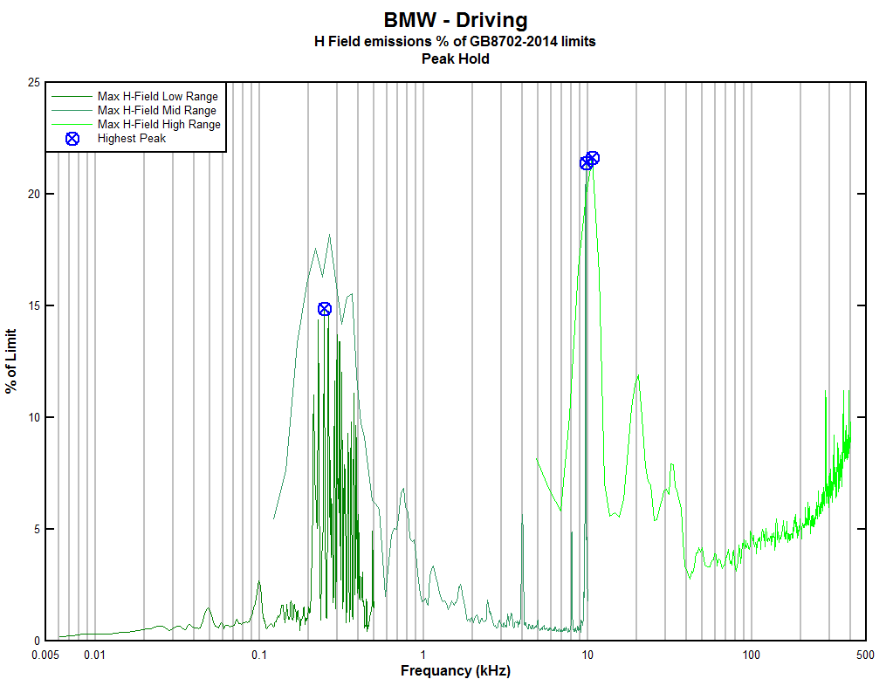
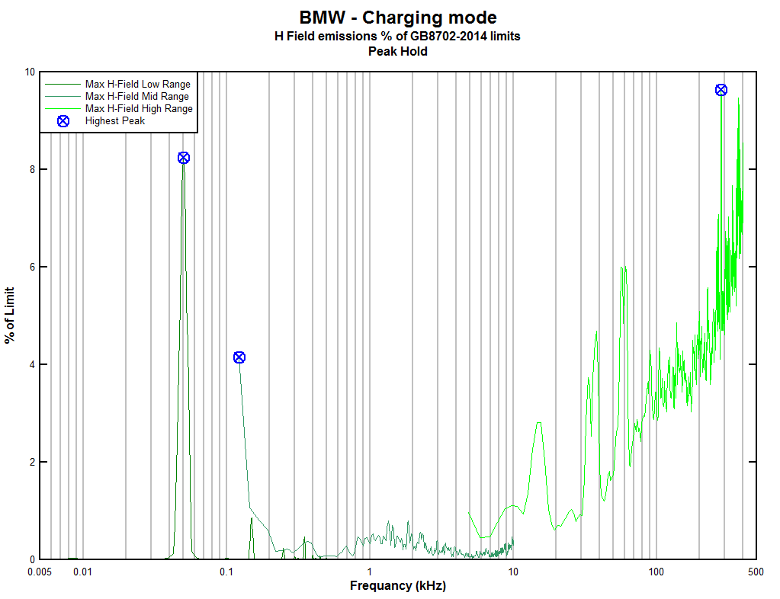
BMW 740Le Data Recorded from location with highest EMF emissions

Slide 5
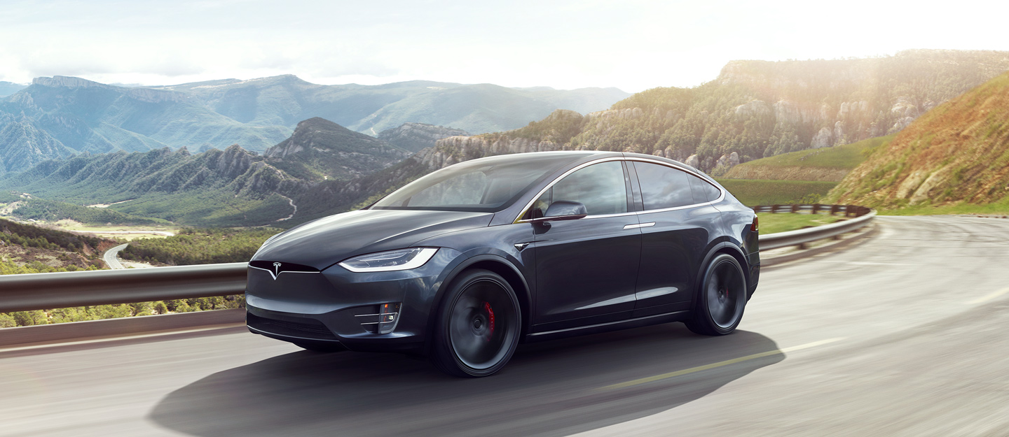
Tesla Model X

Slide 6
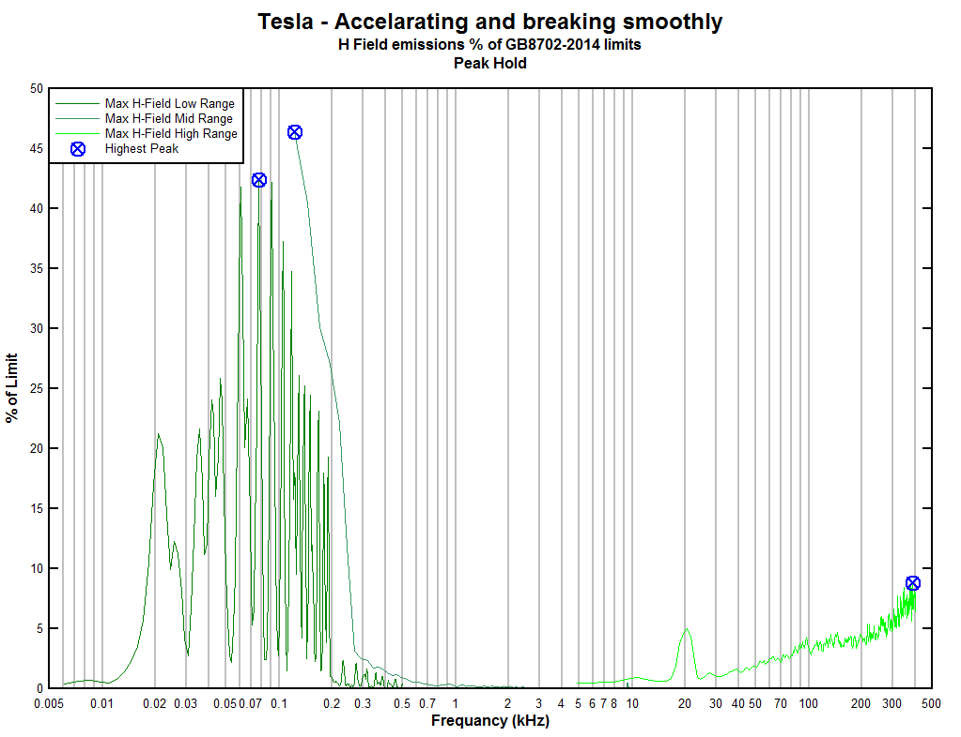
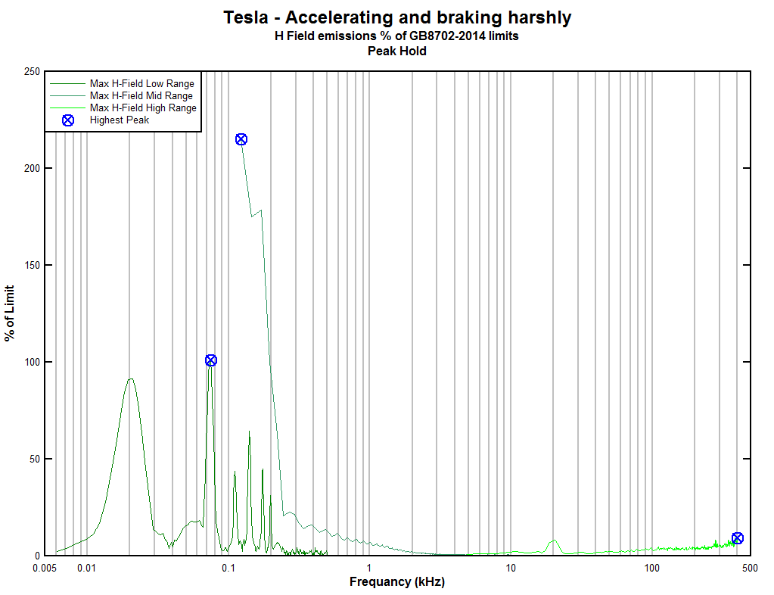
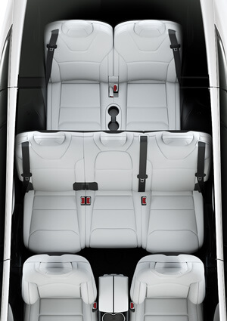
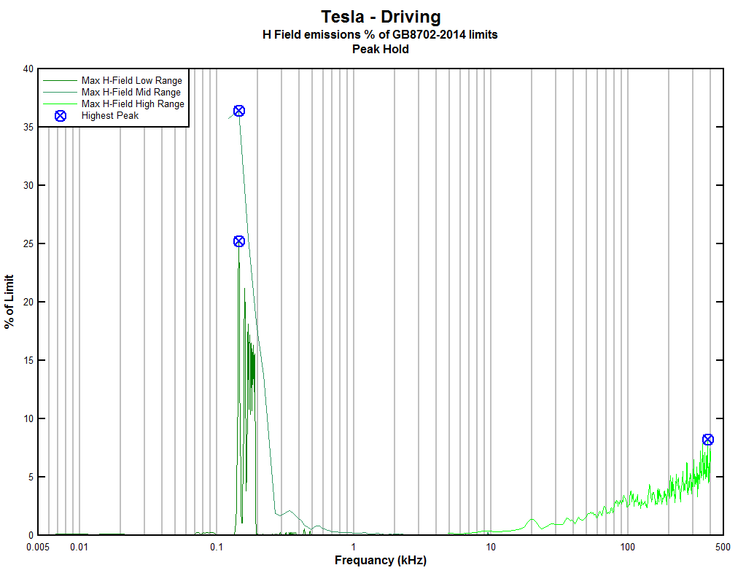
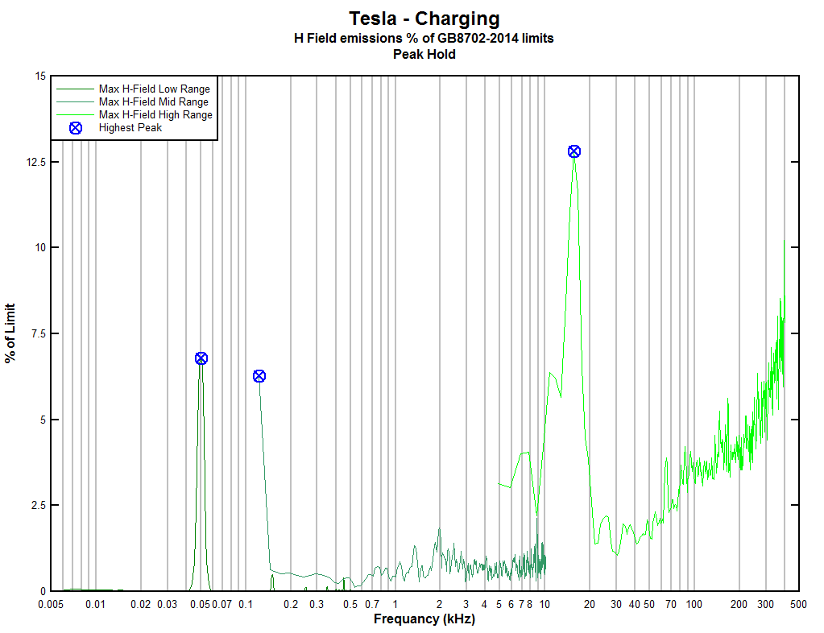
Tesla Model X Data Recorded from location with highest EMF emissions

Slide 7
Tesla Model X Peak data analysis
The 215% Peak is believed to be an artefact of out of band noise, and due to the 10 kHz span has a wider RBW.
Low Range span is 500 Hz
Frequency recorded is 6.1 to 502.9 Hz
Mid Range span is 10 kHz
Frequency recorded is 0.122 to 10.059 kHz
High Range span is 400 kHz
Frequency recorded is 4.883 to 402.343 kHz

